Slide 1


Unit 3
Foreign Food

Slide 2

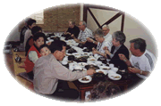
Brainstorming
Vocabulary and listening
villa
dinner party

Slide 3
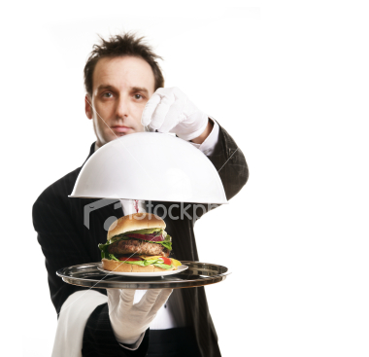
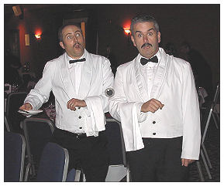
butler
waiters

Slide 4

Pre-listening
guest
fork
n.客人
n.叉子
Predict the answers of Activity 1, 2 & 3

Slide 5
Listening
giving dinner parties
1
1 The ____ is the person who invites you.
2 The _____ is the person who is invited.
3 If you are _____, you behave badly.
4 If you are ______, you behave well.
2
host
guest
rude
polite

Slide 6

1 In some European countries it is rude to arrive ___ for dinner.
(a) early (b) late (c) on time
2 You should put the knife and fork __.
(a) on the tablecloth (b) on the plate (c) separately
3

Slide 7
3 A member of the Royal Family ___ the food she didn’t like.
(a) ate up (b) picked up (c) cut up
4 For some people ____ you eat is more important than what you eat.
(a) how (b) where (c) when

Slide 8


4
Table manners in Britain
1 arrive on time
2 choose where to sit
3 wait for your host to pick up a knife and fork
4 ask for something that isn’t on the table
5 eat with your fingers
6 put the knife and fork on the tablecloth
7 put the knife and fork together when you finish
8 leave much food on the plate

Slide 9
Everyday English
(1) on the dot
(2) as a rule
(3) goes without saying
(4) make a beeline
(5) on close terms with
(6) the done thing

Slide 10
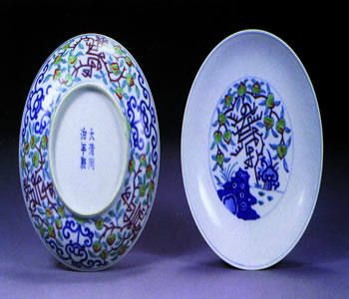
The Willow Pattern Plate
Cultural Corner

Slide 11
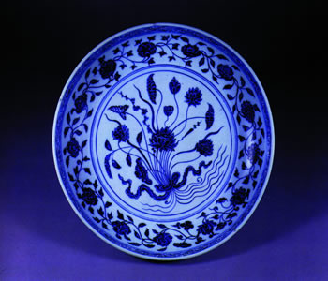
The Chinese traditional Willow Pattern Plates

Slide 12
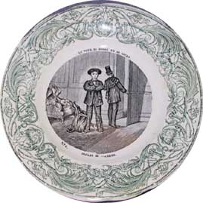
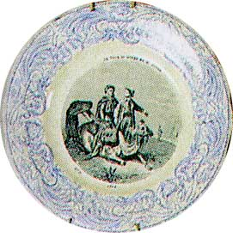
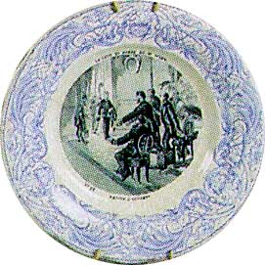
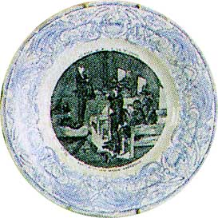
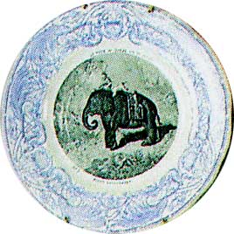
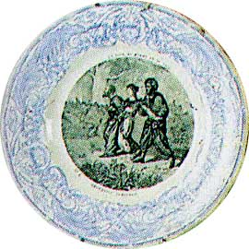
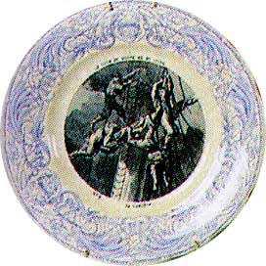
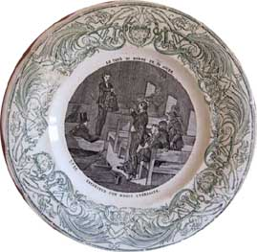
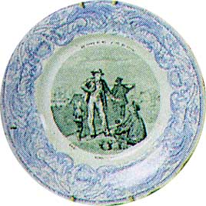
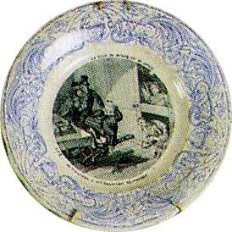
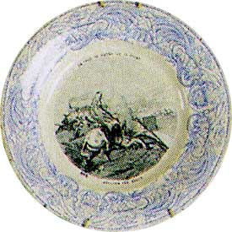

Slide 13
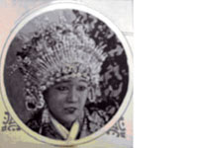
●《青花瓷盘的传说》
●拍摄时间： 约1927年前
●拍摄地点： 上海、杭州
The Legend of the Willow-Pattern Plate

Slide 14
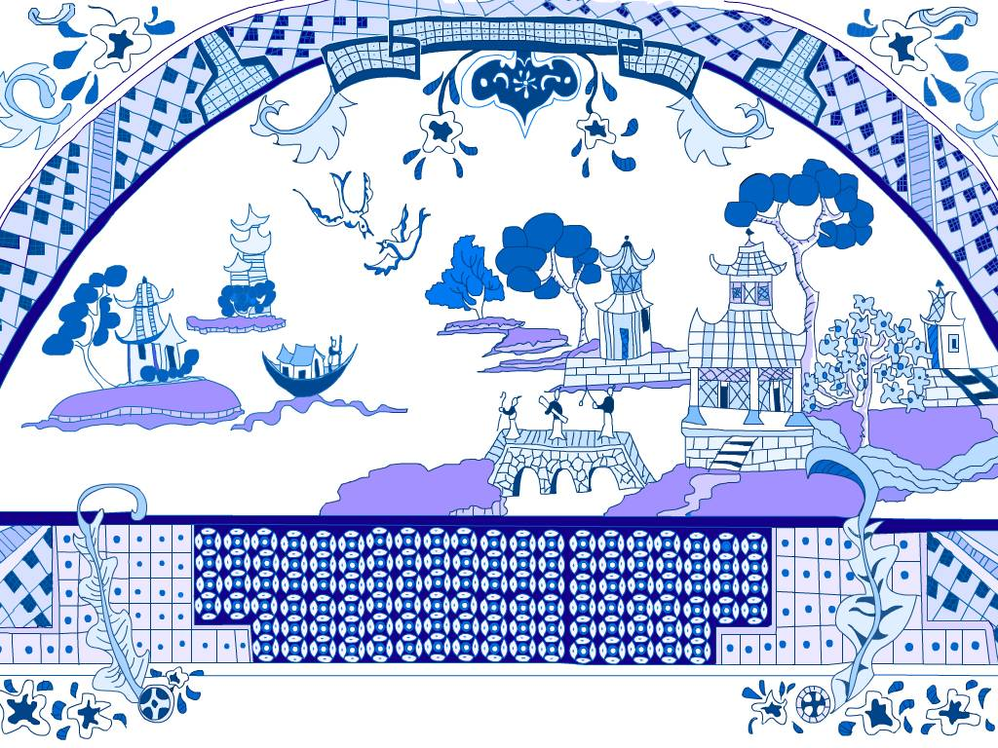
willow pattern（青花杨柳）

Slide 15
Fast reading
What is the story of the willow pattern plate?
The willow pattern plate shows a romantic scene based on an old Chinese story about the daughter of a rich Mandarin. She was in love with a gardener. Her father was very angry and tried to stop them from being together but they ran away. They were killed in afire started by the girl’s father but their souls became songbirds which we can see in the picture of the willow pattern design.

Slide 16
Careful reading
1. The passage is mainly about ______.
A. willow tree B. a love story
C. a pattern plate
D. two songbirds
C

Slide 17
2. The Mandarin tried to stop his daughter from marrying the young man, perhaps because ______.
A. the young man was too poor
B. the Mandarin looked down upon him
C. the status of the young man was low
D. all the above
D

Slide 18
3. Which of the following statements is false? ( )
A. The willow pattern plates are kept for special occasions.
B. The first plates of this kind were made in about the seventeenth century.
C. No original Chinese designs included all the designs together.
D. At last the daughter of the Mandarin and the young man were burnt to death.
B

Slide 19
Homework
Can you describe the picture on the plate again, with the help of the book and the picture?

